Slide 1

Physics 1
Voronkov Vladimir Vasilyevich

Slide 2
Lecture 9
Insulators and Conductors in electric field.
Capacitance, Dielectrics.
Current, resistance.
Electromotive Force.

Slide 3
Conductors and Insulators
Electrical conductors are materials in which some of the electrons are free, that are not bound to atoms and can move relatively freely through the material.
Electrical insulators are materials in which all electrons are bound to atoms and can not move freely through the material.

Slide 4
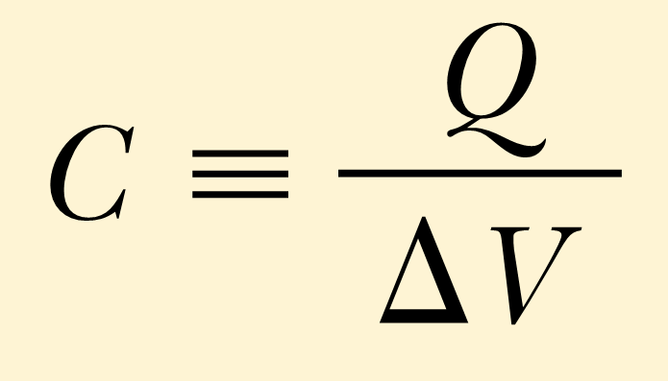
Capacitance
The capacitance C of a capacitor is defined as the ratio of the magnitude of the charge on either conductor to the magnitude of the potential difference between the conductors:
Note: net charge of a capacitor is zero. A capacitor consists of 2 conductors, and Q is the charge on one of each, and correspondingly –Q is the charge on the other.
Do not confuse C for capacitance with C for the unit coulomb.
Usually V is taken instead of ΔV for simplicity.

Slide 5
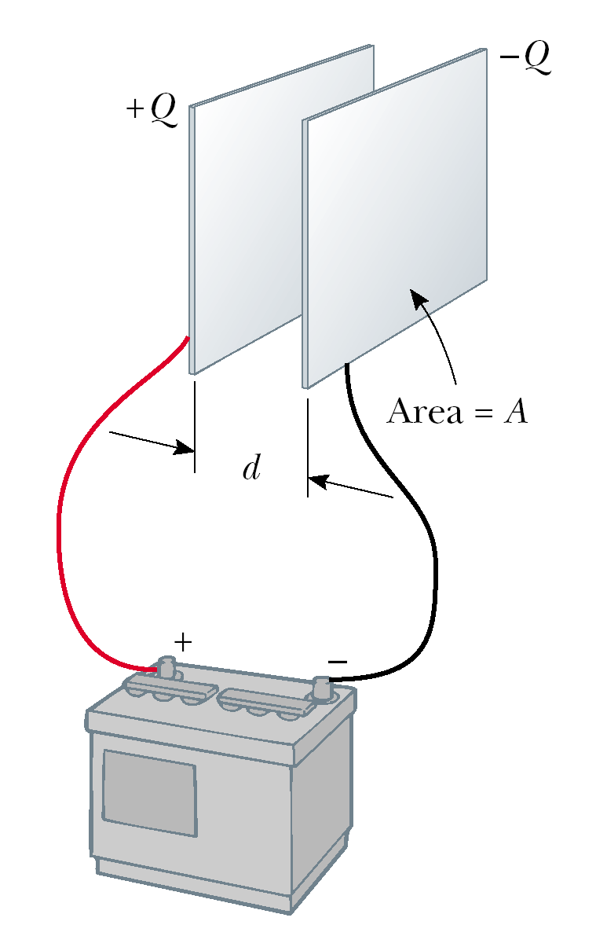
Parallel – Plate Capacitor
A parallel-plate capacitor consists of two parallel conducting plates, each of area A, separated by a distance d. When the capacitor is charged the plates carry equal amounts of charge. One plate carries positive charge, and the other carries negative charge.

Slide 6
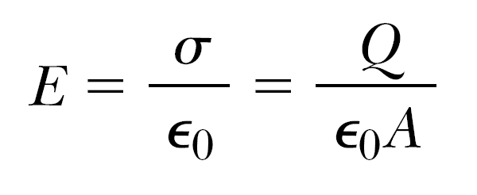
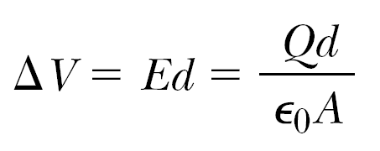
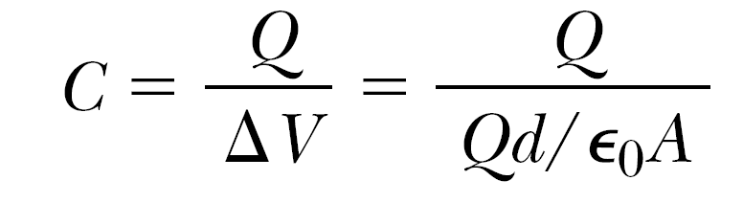
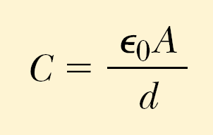
Using the Gauss theorem we can find that the value of the electric field between plates is
The magnitude of the potential difference between the plates equals:
And finally:
So the capacitance of a parallel-plate capacitor is
Here A is the area of each plate, d is the distance between plates.

Slide 7
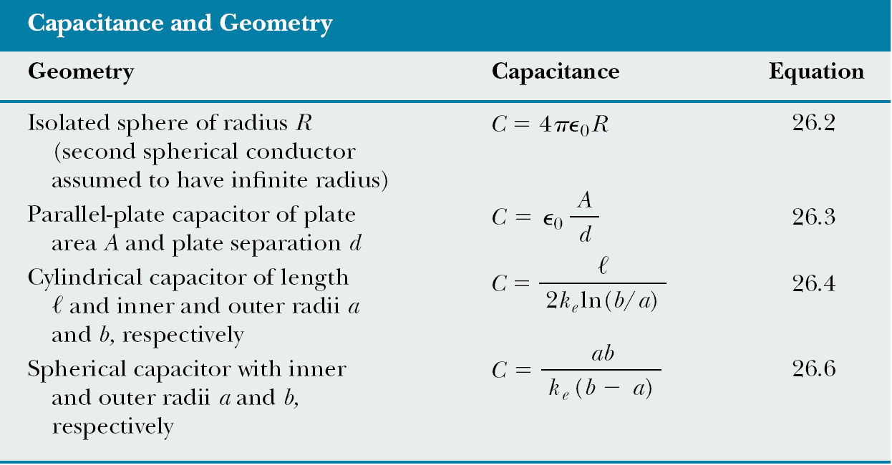
Capacitance of various Capacitors

Slide 8
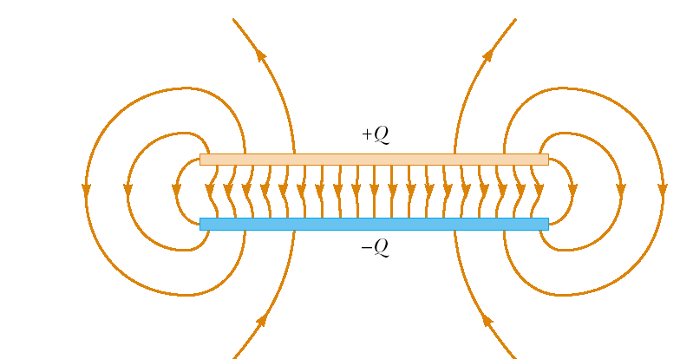
The electric field between the plates of a parallel-plate capacitor is uniform near the center but nonuniform near the edges.
That’s why we applied formula for electric field between two infinite uniformly charged planes:

Slide 9
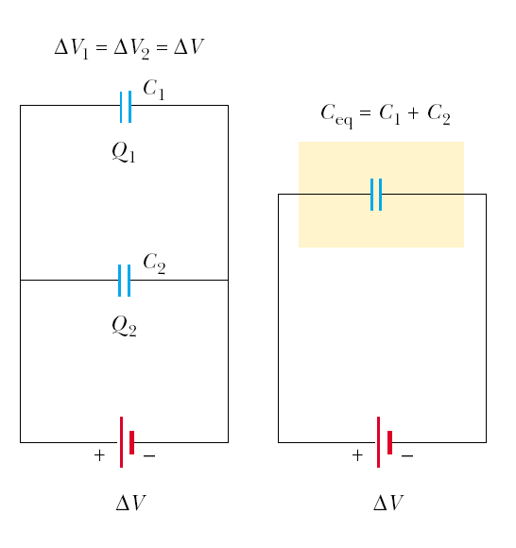
Parallel Combination of Capacitors
C_{eq}=C₁+C₂
Q_{net}=Q₁+Q₂
V=V₁=V₂

Slide 10
Parallel Combination of Capacitors
The equivalent capacitance of a parallel combination of capacitors is the algebraic sum of the individual capacitances and is greater than any of the individual
capacitances.
C_{eq}=C₁+C₂+C₃+…
The total charge on capacitors connected in parallel is the sum of the charges on the individual capacitors:
Q_{net}=Q₁+Q₂+Q₃+…
The individual potential differences across capacitors connected in parallel are the same and are equal to the potential difference applied across the combination:
V=V₁=V₂=V₃=…

Slide 11
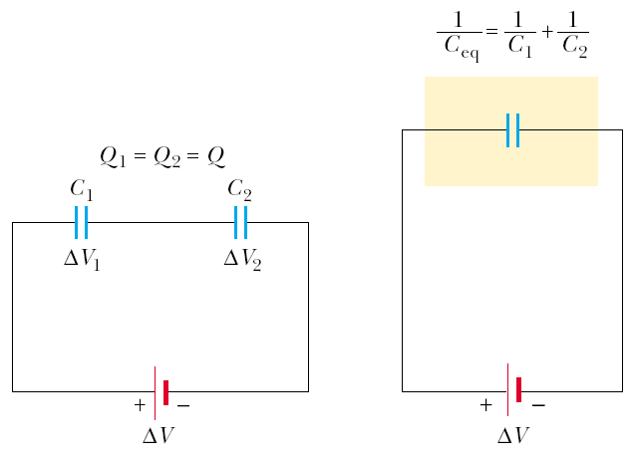
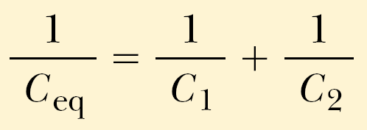

Series Combination of Capacitors
Q=Q₁=Q₂
V=V₁+V₂
1

Slide 12
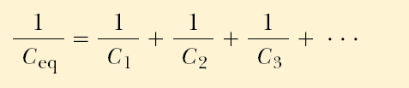
Series Combination of Capacitors
The charges on capacitors connected in series are the same:
Q=Q₁=Q₂=Q₃=…
The total potential difference across any number of capacitors connected in series is the sum of the potential differences across the individual capacitors:
V_{net}=V₁+V₂+V₃+…
The inverse of the equivalent capacitance is the algebraic sum of the inverses of the individual capacitances and the equivalent capacitance of a series combination is always less than any individual capacitance in the combination:

Slide 13
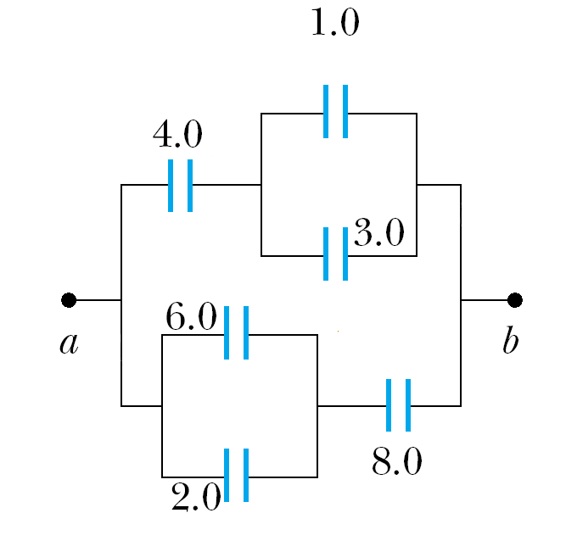
Capacitors Parallel-Series Combinations:
Let’s calculate the equivalent capacitance step by step, using the mentioned above properties of capacitors:
First we merge parallel capacitors into one: using that C_{parallel}=C₁+C₂+…

Slide 14
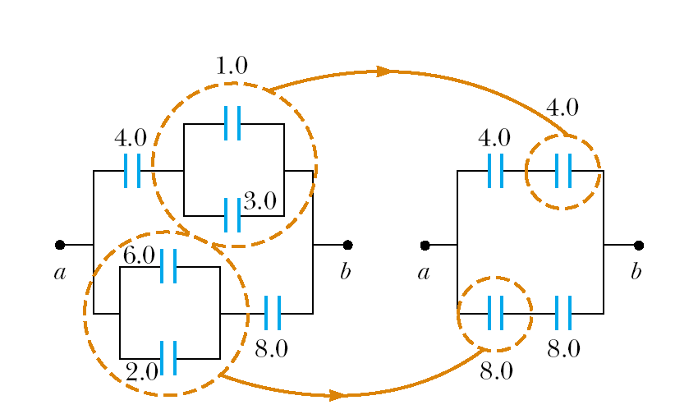
1. Merging parallel capacitors:

Slide 15
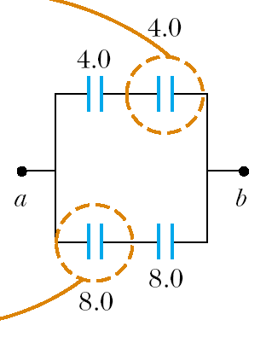
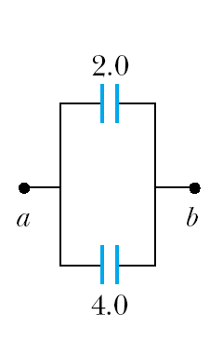
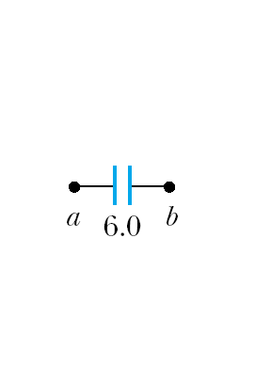
2. Joining serial capacitors:
And finally we join the two parallel conductors into one:
In circles we have merged capacitors:
Then we join series conductors:

Slide 16
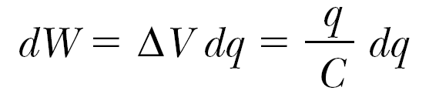
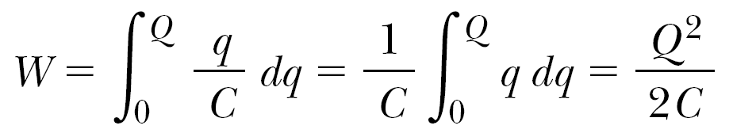
Energy Stored in a Charged Capacitor
If a capacitor has charge Q then it’s difference of potentials V is V=Q/C, then the work dW, necessary to transfer small charge dq from one capacitor’s conductor to another is:
Then the total work required to charge the capacitor from q = 0 to final charge q = Q is

Slide 17
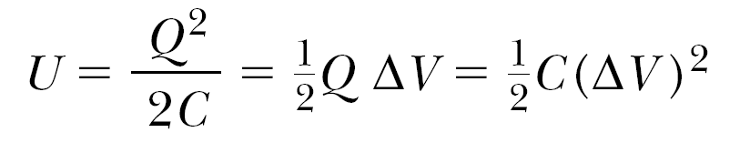
Energy Stored in a Charged Capacitor
The work done in charging the capacitor appears as electric potential energy U stored in the capacitor
Here U is the energy, stored in the capacitor,
ΔV – difference of potentials on the capacitor
This result applies to any capacitor, regardless of its geometry.

Slide 18
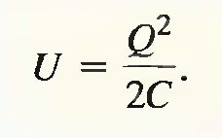
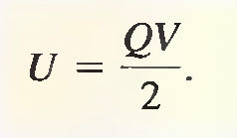
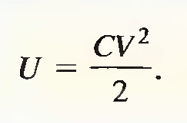
Energy in a Capacitor
Usually V is used instead of ΔV for the difference of potentials, then the expressions for energy, stored in a capacitor is:

Slide 19
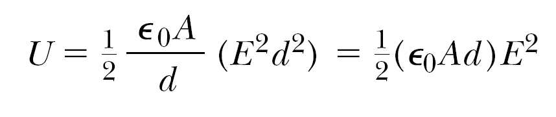
Energy in Electric Fields
Let’s take a parallel-plate capacitor:
V - the potential difference between the plates of a capacitor,
d - distance between the plates,
A – the area of each plate,
E - the electric field between the plates of a capacitor. Then V=Ed.
Then the energy of the electric field in the capacitor is:

Slide 20
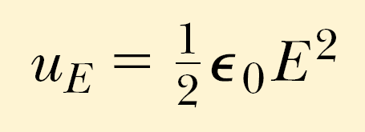
Energy density of Electric Field
The volume, occupied by the electric field is Ad, then the energy density of the electric field is:
The energy density in any electric field is proportional to the square of the magnitude of the electric field at a given point.

Slide 21
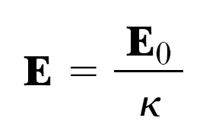
Dielectrics
Many materials (like paper, rubber, plastics, glass …) do not conduct electricity easily – we call them insulators.
But they modify the electric field they are placed in, that’s why they are called dielectrics.
E₀ – the electric field without the dielectric
E – the electric field in the presence of the dielectric
k – the dielectric constant

Slide 22
Dielectric strength
The dielectric strength equals the maximum electric field that can exist in a dielectric without electrical breakdown. Note that these values depend strongly on the presence of impurities and flaws in the materials.

Slide 23
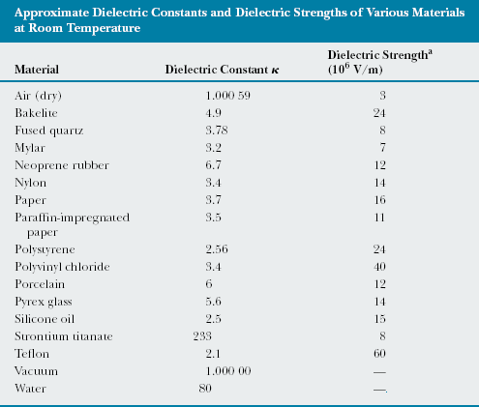

Slide 24
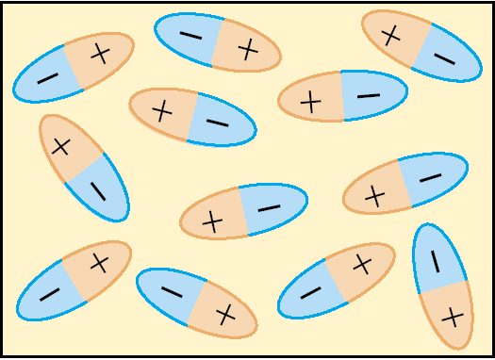
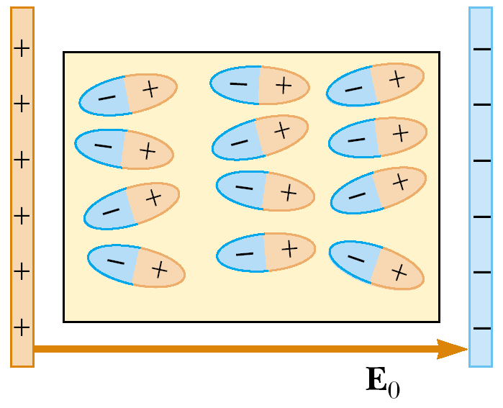
Atomic Description of Dielectrics
Dielectric can be made up of polar molecules. The dipoles are randomly oriented in the absence of an electric field.
When an external Electric field is applied, its molecules partially align with the field. Now the dielectric is polarized.

Slide 25
Polar and Nonpolar molecules of Dielectric
The molecules of the dielectric can be polar or nonpolar.
The case of polar molecules are considered in the previous slide.
If the molecules of the dielectric are nonpolar then the electric field produces some charge separation in every molecule of the dielectric, and an induced dipole moment is created. These induced dipole moments tend to align with the external field, and the dielectric is polarized.
Thus, we can polarize a dielectric with an external field regardless of whether the molecules are polar or nonpolar.

Slide 26
Dielectric polarization
The degree of alignment of the molecules with the electric field depends on temperature and on the magnitude of the electric field.
In general, the alignment increases with decreasing temperature and with increasing electric field.

Slide 27
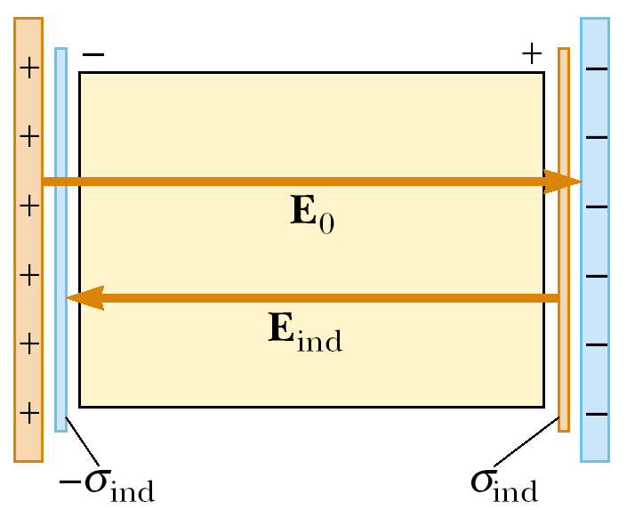
Induced Electric field in Dielectric
When an external field E₀ is applied, a torque is exerted on the dipoles, causing them to partially align with the field.
That’s why dielectric’s molecules produces induced electric field E_{ind}, opposite to the external E₀.

Slide 28
Capacitor with Dielectric
So the electric field is k times less in a capacitor with a dielectric, its dielectric constant is k:
Then, the potential difference is k times less:
without dielectric: V₀ =E₀d
with dielectric: V=Ed= E₀d/k.
V=V₀/k.

Slide 29
As the charge Q on the capacitor is not changed:
C₀=Q/V₀, V=V₀/k
C=Q/V=kC₀V₀/V₀=kC₀
C=kC₀
So the capacitance increases in k if a dielectric completely fills the distance between the plates of a capacitor.

Slide 30
Usage of Dielectrics in Capacitors
Insulating materials have k>1 and dielectric strength greater than that of air, so usage of dielectrics has following advantages:
  Increase in capacitance.
  Increase in maximum operating voltage.
  Possible mechanical support between the plates, which allows the plates to be close together without touching, thereby decreasing d and increasing C.

Slide 31
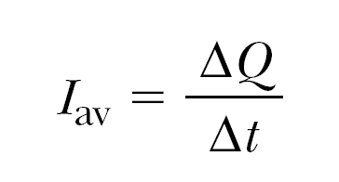
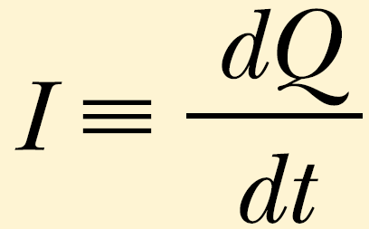
Electric Current
Electric current (or just current) is defined as the total charge that passes through a given cross-sectional area per unit time.
Current can be composed of
  moving negative charges such as electrons or negatively charged ions;
  moving positive charges such as protons or positively charged ions.
ΔQ - the amount of charge passing through the cross sectional area of a wire
ΔT - a time interval of the passing.
The average current is:
The instantaneous current is:

Slide 32
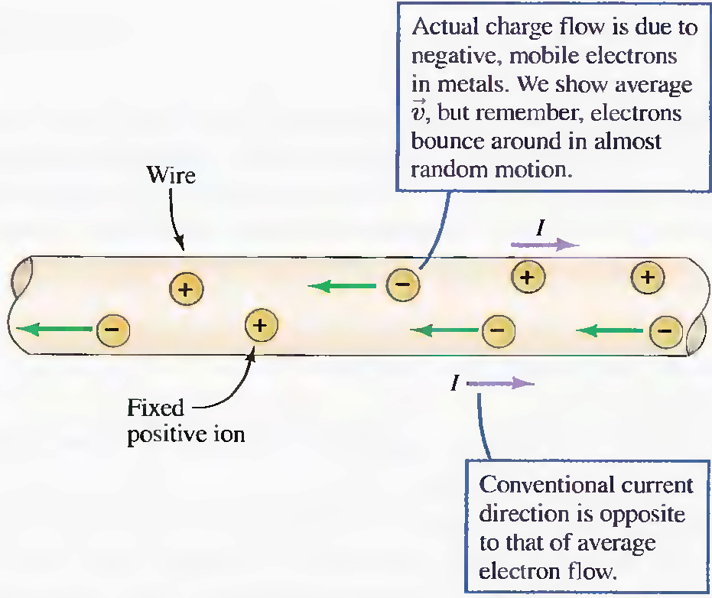
Current direction
By convention the direction of the current is the direction of positive charges would move.

Slide 33
Ohm’s Law
Ohm’s law states that
For many materials the resistance is constant over a wide range of potential differences:
V = IR.
Resistance is defined as the opposition to the flow of electric charge.

Slide 34
Electromotive Force
A device with the ability to maintain potential difference between two points is called a source of electromotive force (emf). The most familiar sources of emf are batteries and generators.
Batteries convert chemical energy into electric energy.
Generators transform mechanical energy into electric energy.
Since emf is work per unit charge, it is expressed in the same unit as potential difference: the joule per coulomb, or volt.

Slide 35
Units in Si
Capacitance C F=C/V
Current I A=C/s
Resistance R Ohm=V/A
Electro motive force (emf) εV
Energy density u_{E} J/m³=kg/(m*s²)

